Slide 1

Data Sonification of Red-Shifted Galaxies
Emily Neel with Dr. James Rhoads
School of Earth & Space Exploration

Slide 2
The Project:
Taking emission spectra from red-shifted galaxies and converting the wavelengths of light into frequencies of sound, which can be played in audio software.

Slide 3
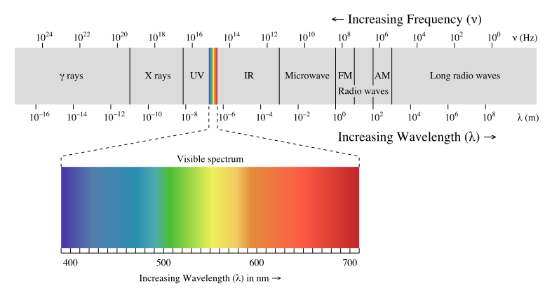
The Light Spectrum

Slide 4
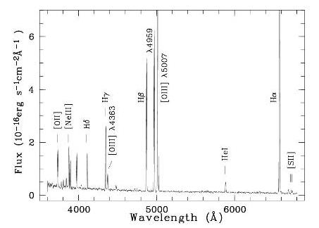
Emission Spectra
Variations in emission
spectra can be due to:
Elemental composition

Slide 5
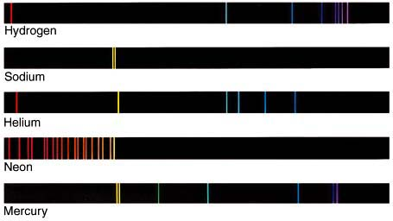
Emission Spectra
Variations in emission
spectra can be due to:
Elemental composition

Slide 6
Emission Spectra
Variations in emission
spectra can be due to:
Elemental composition
Ionization
Dust and gas
Star formation history
Distance from Earth

Slide 7


Producing Sound
Convert wavelength to frequency
$$Frequency=\frac{C}{Wavelength}$$
Lower the frequency range
$$\frac{Frequency}{{10}^{12}}$$

Slide 8

Producing Sound
Sine oscillations
Pink noise
Red Shift
Fourier transforms

Slide 9
Looking Forward
User friendly
Web interface

Slide 10
Sources:
Image 1 – Light Spectrum: http://commons.wikimedia.org/wiki/File:EM_spectrum.svg
Image 2 – Galaxy Emission Spectrum: http://www.hs.uni-hamburg.de/DE/For/Exg/Sur/hqs/publications/references/kniaze00.html
Image 3 – Elements Emission Spectra http://www2.astro.psu.edu/users/caryl/a10/lec6_2d.html

